Slide 1
BrightFish Reading
Model Lessons: Activities Introduction for Students

Slide 2
Welcome!
Welcome to BrightFish Reading! In this video, we’ll review highlights of the program and tips for getting the most out of your work.

Slide 3
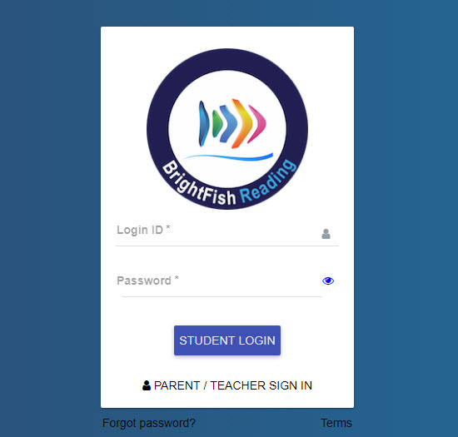
First, you’re going to log Into
BrightFish Reading
The website is go.brightfishlearning.com
Type your login ID – assigned by your teacher.
Type your password – assigned by your teacher.
Press Student Login.

Slide 4
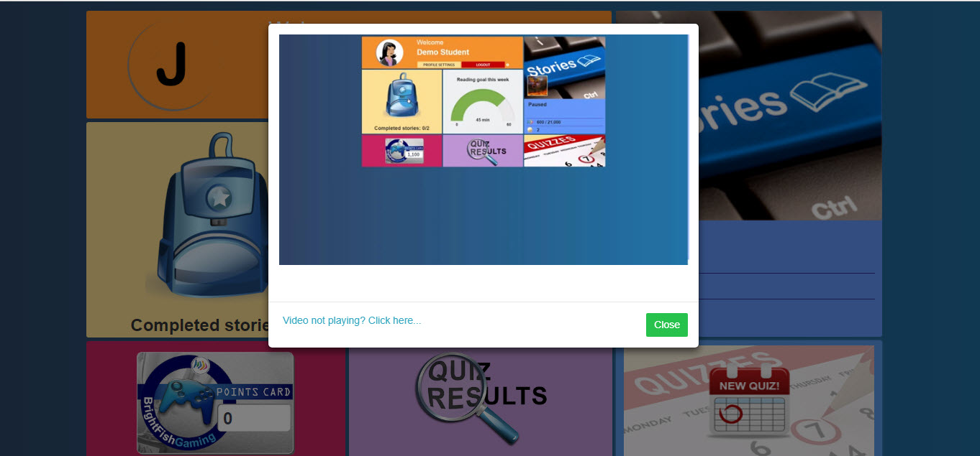
Watch the Video and tutorials to learn how to use the program.

Slide 5
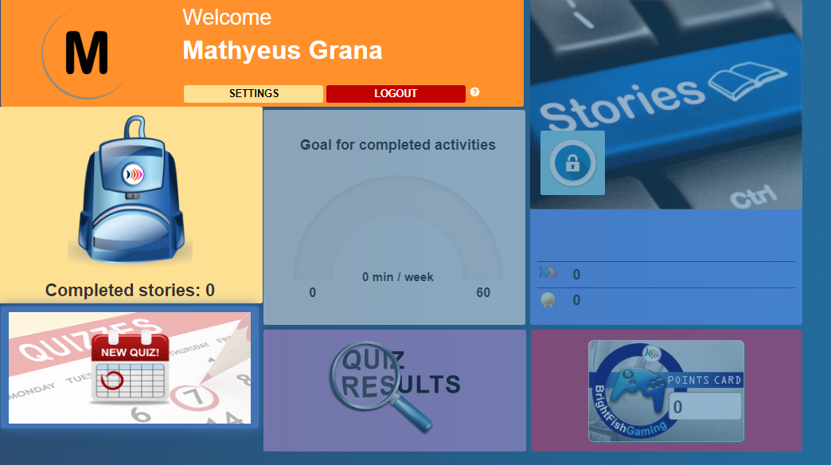
Click on the New Quiz icon to start your first activity.
Your Name Here

Slide 6
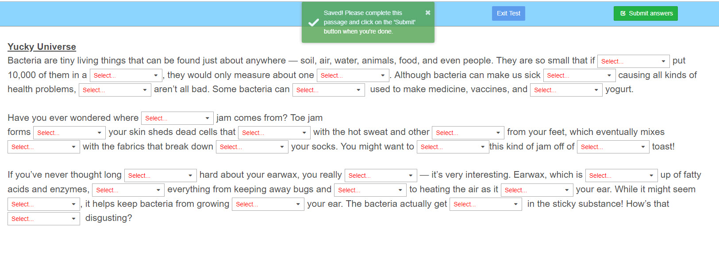
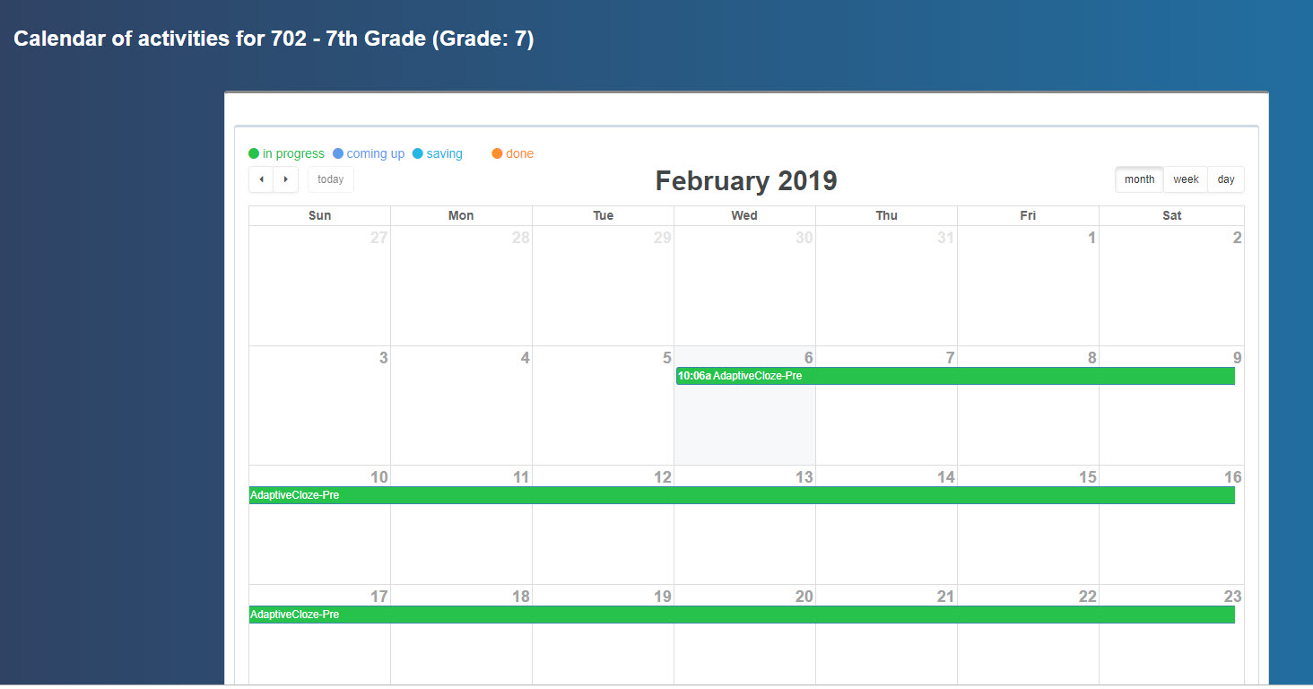
Click on the green bar in your calendar to start the test. Choose the best word in the “select” box to complete a sentence. Take your time and re-read the passage after you make the selections. Press save when you’re done – then work on the next passage. You may do up to four of these passages.

Slide 7
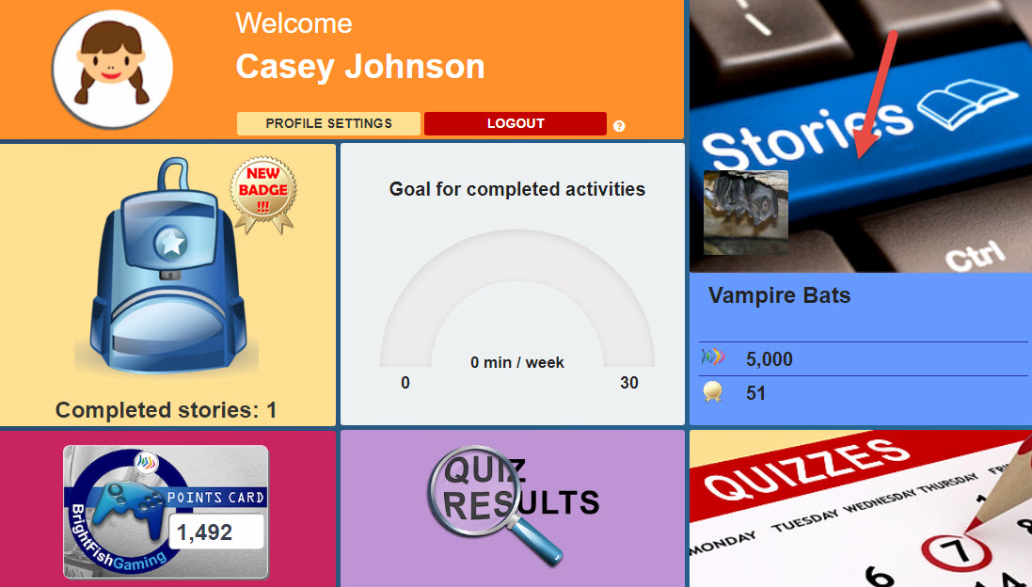
Now you are ready to start working on a story. Click on the Stories Tile to start.

Slide 8
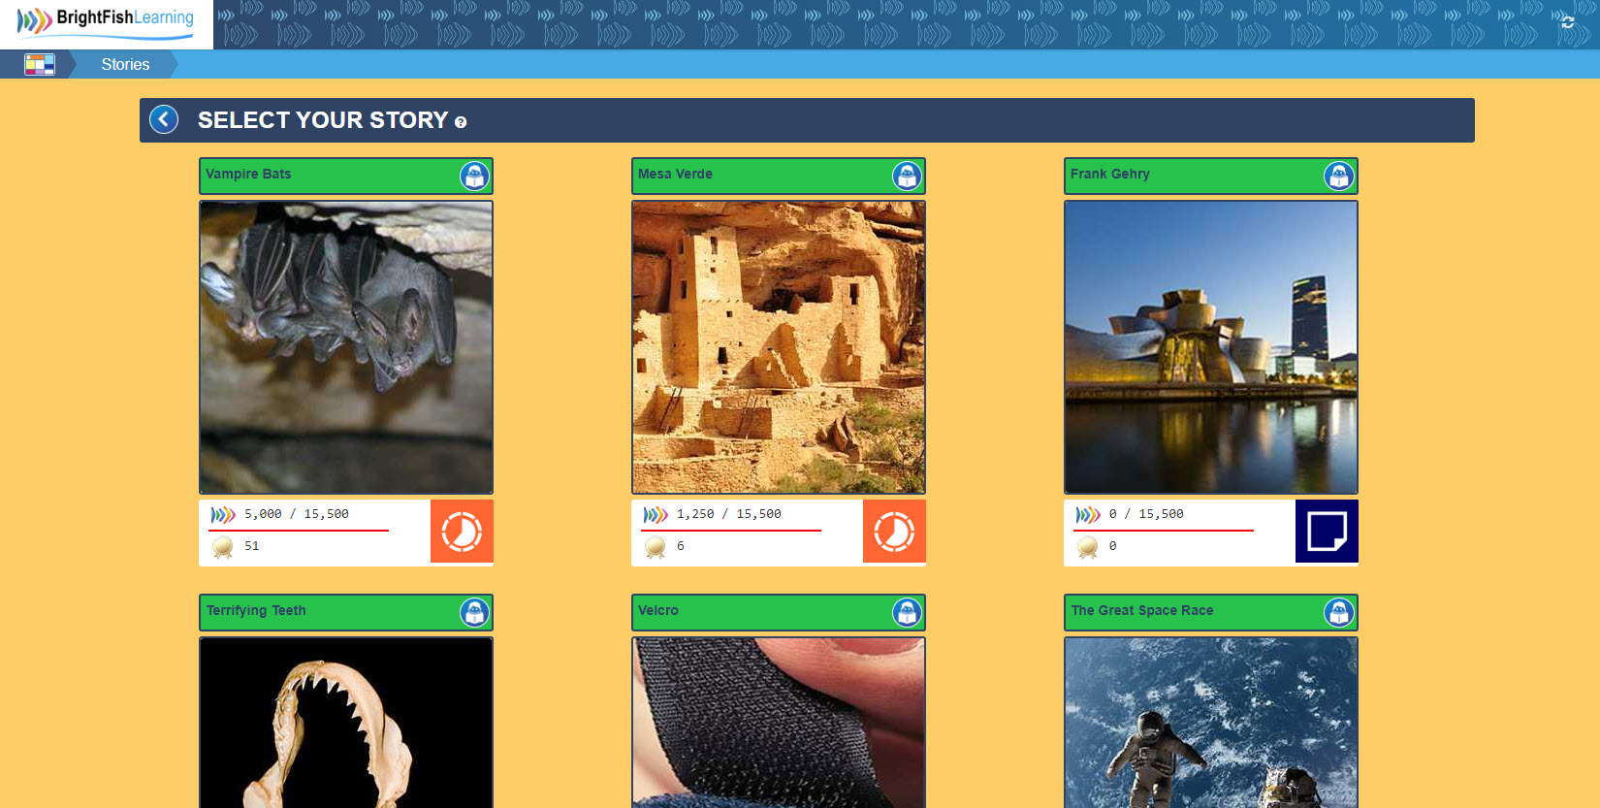
Click on any story to start. To preview a story, click on the Lock icon in the next to the story title. The tile will flip and you can read the first paragraph.

Slide 9
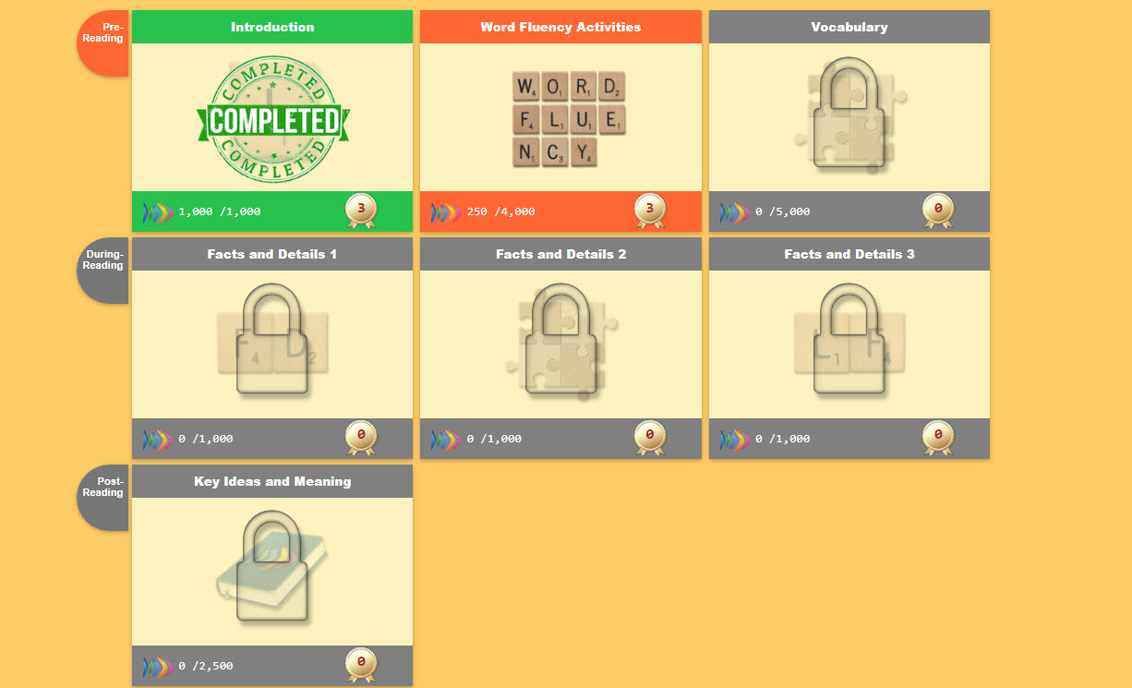
Each story unit contains puzzle pieces for you to complete. Each time you finish a piece, the color will change and you will see how many points you have earned. The next piece will be unlocked until you have finished each one.

Slide 10
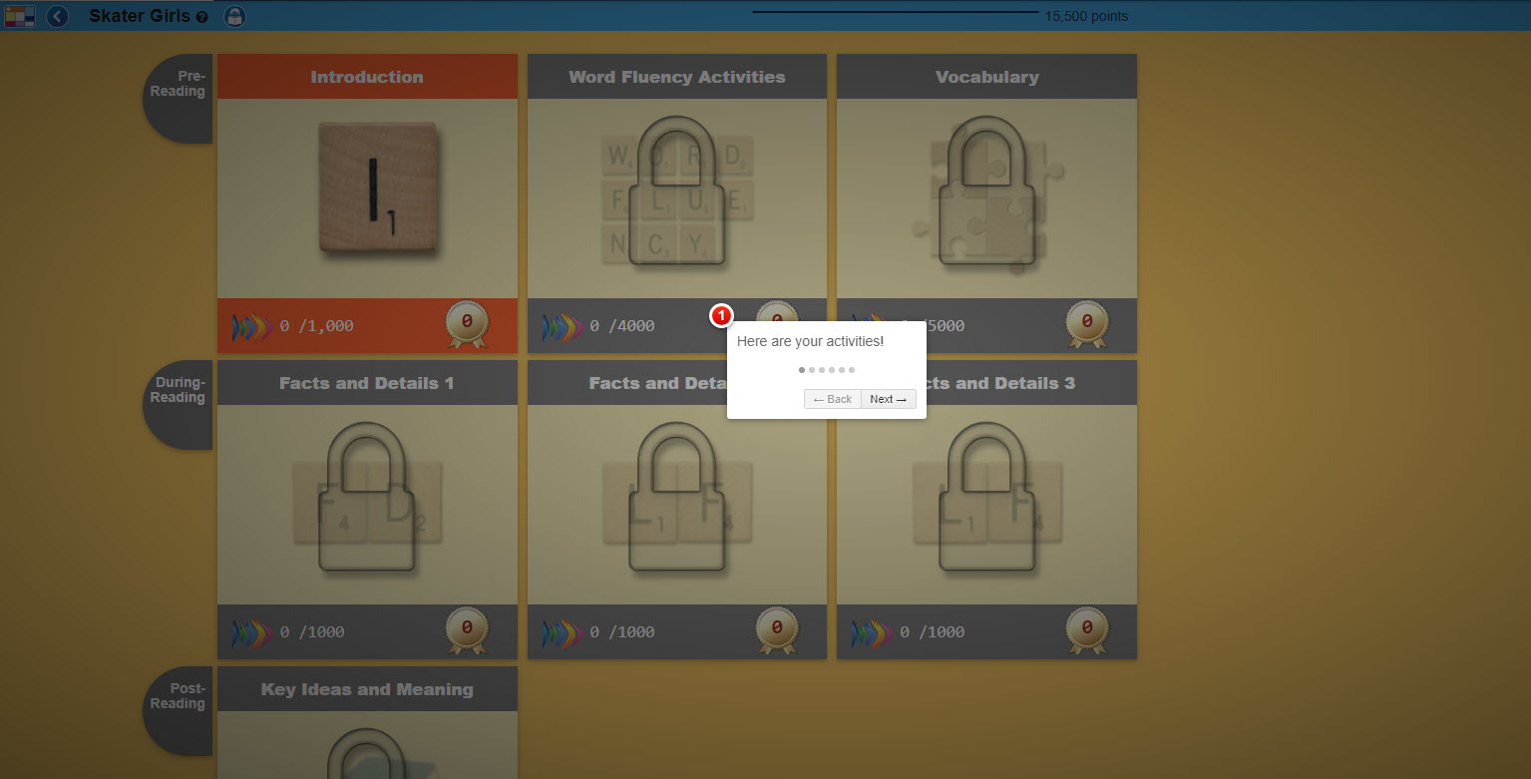
Introduction: Watch the tutorial and answer 2 warm-up questions. These questions aren’t scored, but you can earn some points to get started!

Slide 11
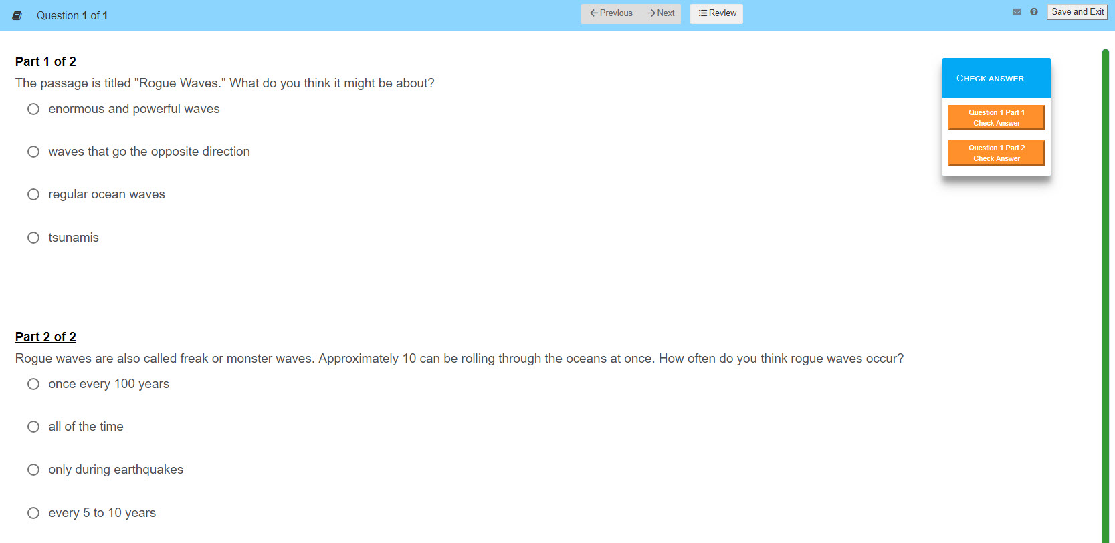

Slide 12
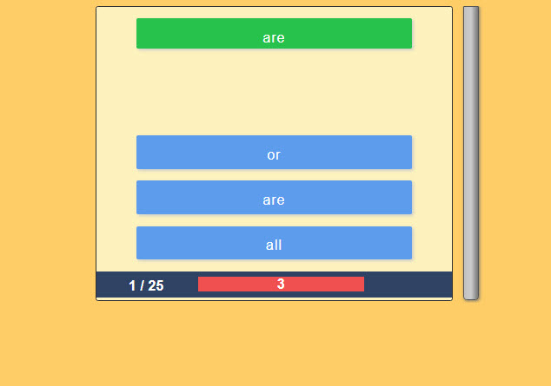
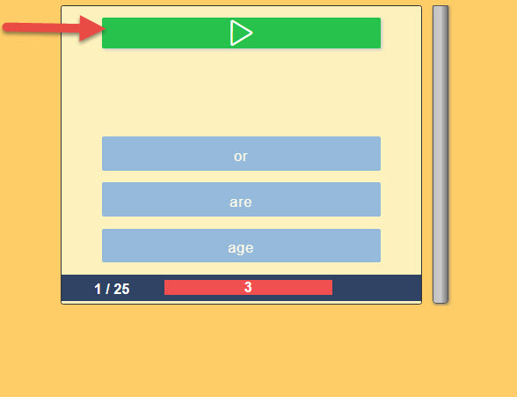
Fluency: You will be working on all of the words and phrases in the story.
In Word for Word, select the correct match for the target word.
In Sound for Word, press “play” to hear the word or phrase and select the best match from the list. The system will be checking your accuracy and speed. Before you start, watch the tutorial for tips on how to master this activity!

Slide 13
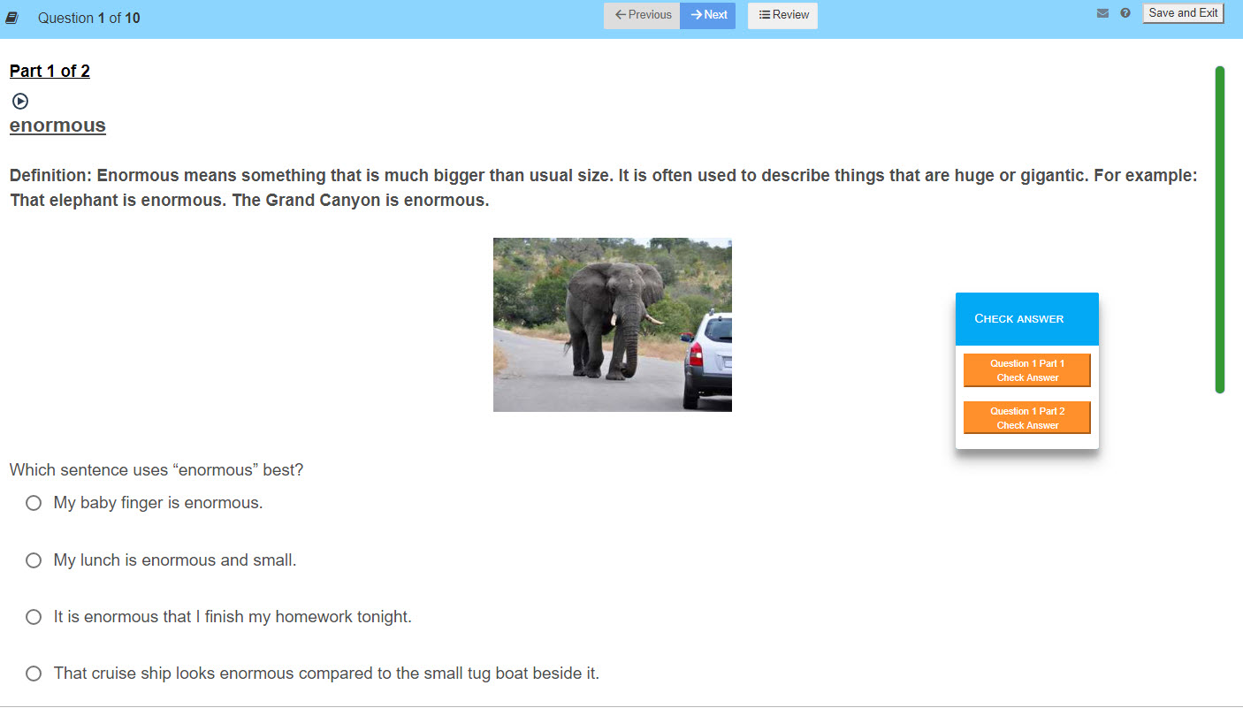

Activity #1:
Definition/ Applying Knowledge
Vocabulary: First, read the definition and the examples. In part 1, choose the sentence with the best usage of the word. Press “check answer” to see if you are right. You will get maximum points if you get it on the first try!
Hint: The word definition is based on how it’s used in the story. Choose the sentence with the best usage based on the definition provided.

Slide 14
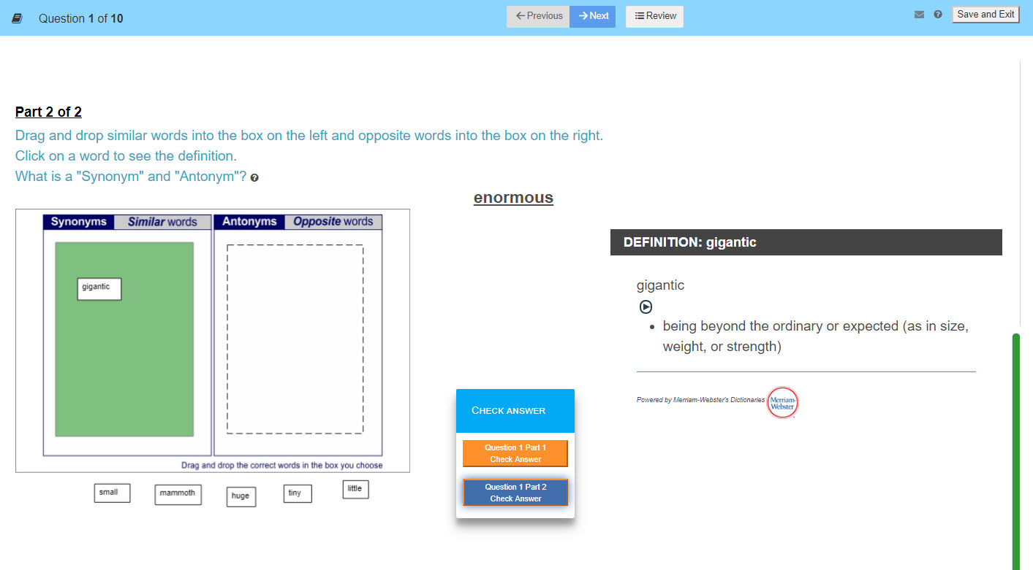
Vocabulary: Part 2 – Synonyms and Antonyms. Sort similar and opposite words based on the target word. Click on the words to see the online dictionary definition if you’re not sure. Press check answer to see if you’re right.
HINT: Refer to the definition of the target word before making your choices. Click on each word to see the definition.
HINT: If you need to make changes, click and drag the word to the new position. Or click reset to move all of the boxes out and start over.

Slide 15
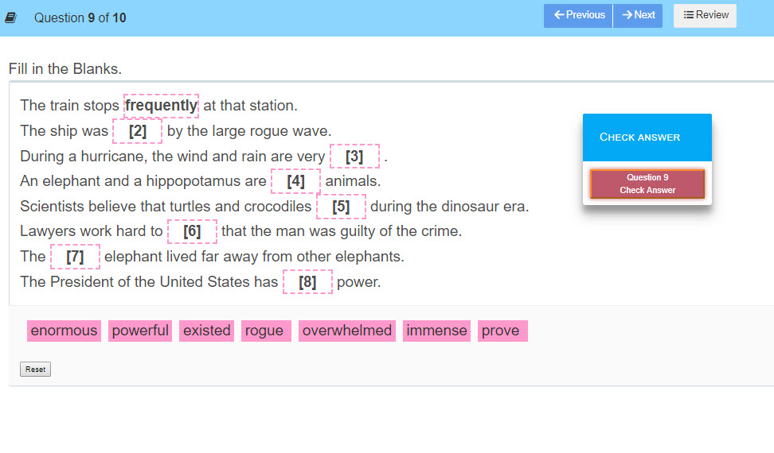
Vocabulary: Fill in the Blanks. Drag and drop the best word to complete each sentence. To change a choice, click on the word and move it out of the box. Then drop the new word in its place. Or press reset to start over. Check your answer!
HELPFUL HINTS:
Read all of the sentences before choosing your answers.
Read through all of the available words before making a selection.
Look for words that make the most sense. Eliminate any words you know won’t fit.
Use a scratch pad to write down the order and then make the matches on the screen.

Slide 16
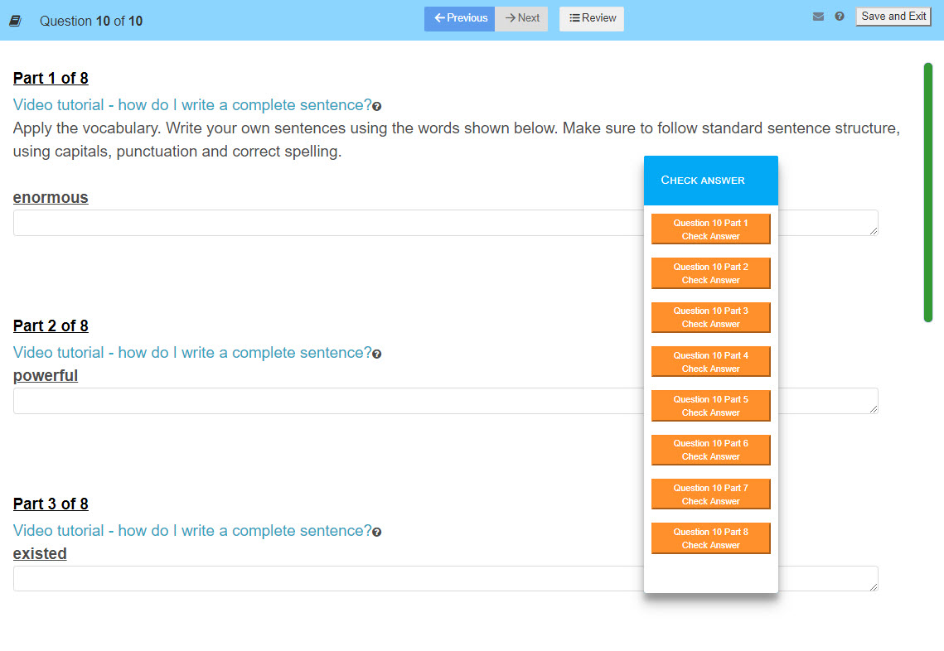
Vocabulary: Write a Sentence. Now that you’ve learned how the words are being applied in the story, write a sentence with that definition in mind. Remember to use capitals and punctuation in your sentences.
HINT: If you need a reminder of how the word is being used, click on the word to see the definition.

Slide 17
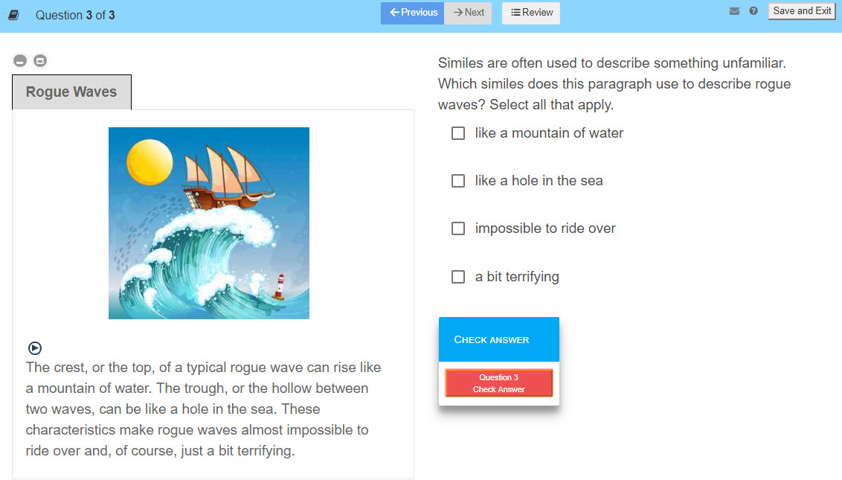
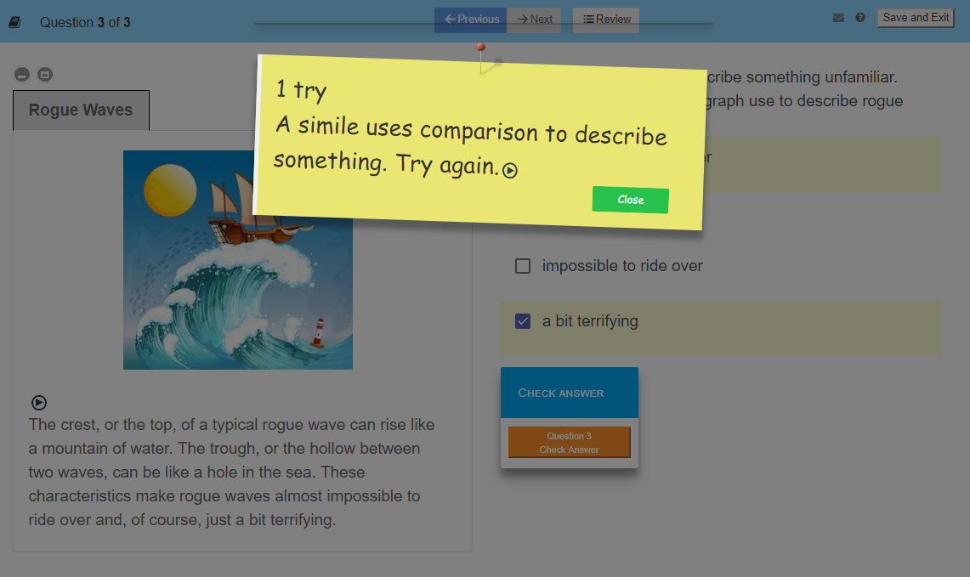
During Reading. Read each paragraph on the left before answering the questions. Click the “play” button to hear the text.

Slide 18
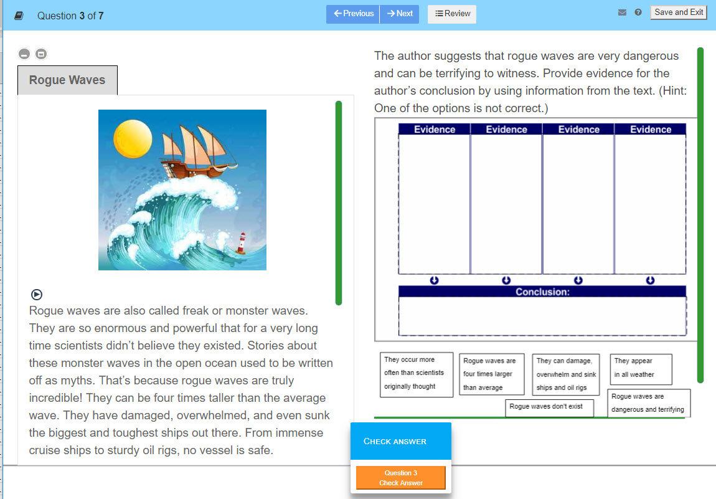
Key Ideas and Meaning:
Author’s Purpose
13. Post Reading. Read the entire story on the left before answering the questions. Use the green scroll bar to view the text. Click the “play” button to hear it.
Hint: Look for relevant details to support the author’s conclusion.

Slide 19
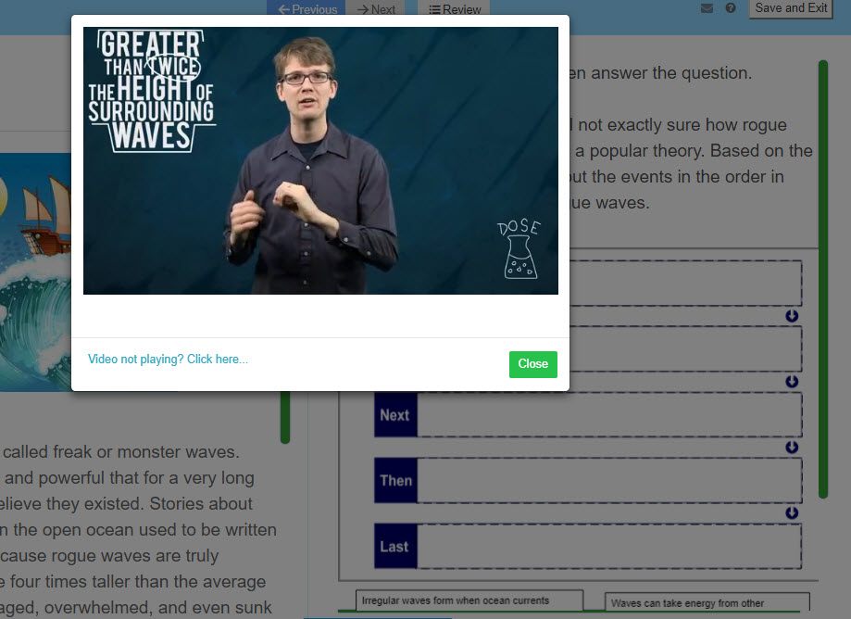

Post Reading. Video questions: Watch the entire video before answering the question. Click to play it again if you missed something.
Hint: Write down the details from video questions to help sort information.

Slide 20
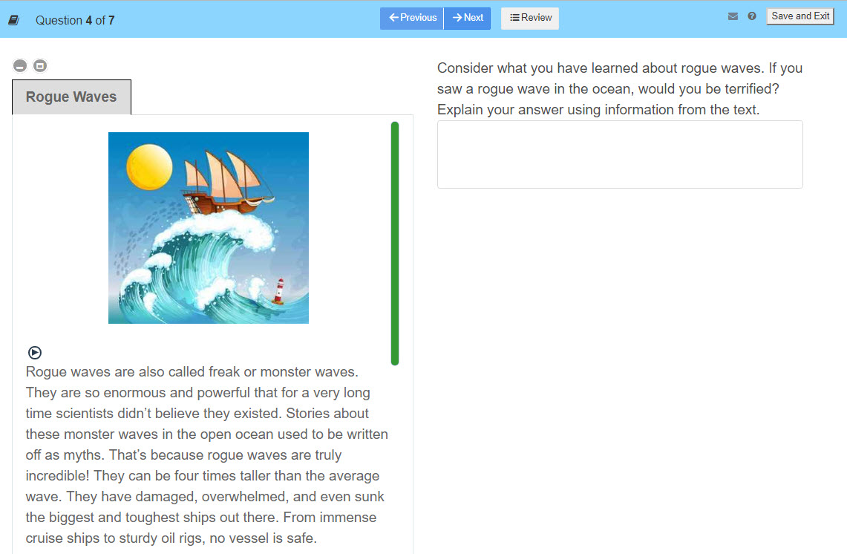
Post Reading – Written Response: Plan your answer before you start writing and locate details from the text to support your position.
Hint: Remember to write your answer using complete sentences, with capitals and punctuation. There is no “check answer” box, but your teacher will be reviewing your answers for content and style.

Slide 21
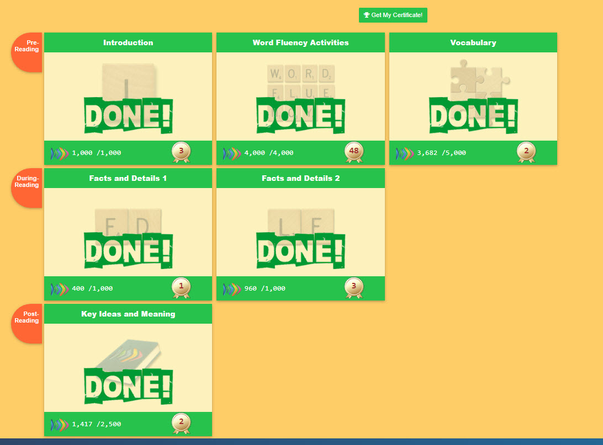

Puzzle Completed! You have finished all of your activities in the story unit. View your certificate and points total in your backpack.

